Slide 1
Cs2030
Tutorial 8
jeremychoo@u.nus.edu

Slide 2
Question 1: parallel binary search
Replace fork and join with just compute
BinSearch should not be parallelized since we always either search the left half or search the right half, but never both at the same time.
In the given code, we could just call left.compute() instead of left.fork() then return left.join(). This reduces the overhead of interacting with the ForkJoinPool and therefore will likely achieve a faster performance.
Swap the order of fork and join
This is obviously wrong. If you call join before fork your program will just wait forever.

Slide 3
Question 1: parallel binary search
Searching for the largest element versus the smallest.
This requires an algorithmic understanding of what the compute method does.
If the item that we are looking for is smaller than the middle element, we search on the left.
This means that the array is sorted in increasing order. So, searching for the smallest element would lead to the code to keep going left (i.e. keep forking and joining). On the other hand, searching for the largest element would lead to the code to keep going to right (i.e. keep invoking compute() which is faster). So, searching for the largest element is faster.

Slide 4
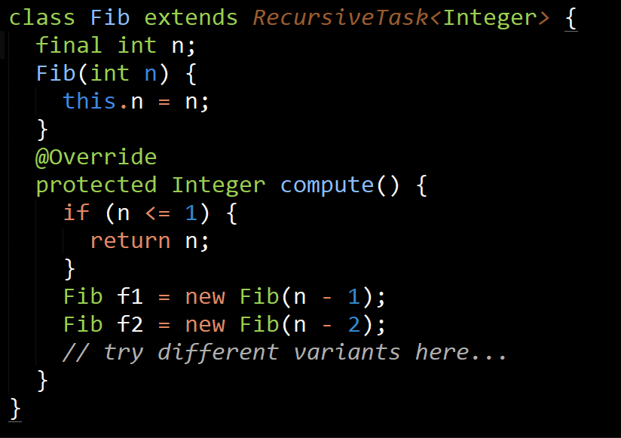
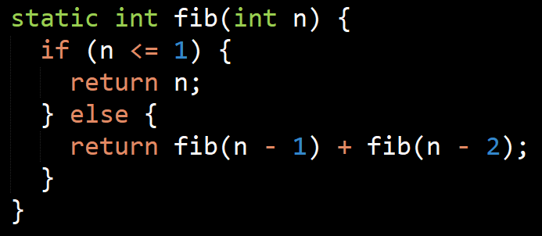
Question 2: Fibonacci
Parallelize the following method:
Explore different variants and combinations of fork, join and compute invocations.

Slide 5


Question 2: Fibonacci parallelism
Simplest example:
Fairly easy to come up with following the lecture example.
This also works:
but is slower (why?)
In Java subexpressions are evaluated left to right.
So f1.join() needs to wait for f1.fork() to complete before f2.compute() can be evaluated.
What about this?
This is sequentially recursive. Not much different from (b), but still slightly faster as there is no overhead involved in forking and joining.

Slide 6
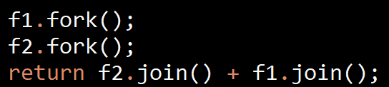
Question 2: Fibonacci parallelism
Fork both and join?
This works, main thead delegates all work to worker threads. But note that main thread doesn’t do much in this case (wasted)

Slide 7
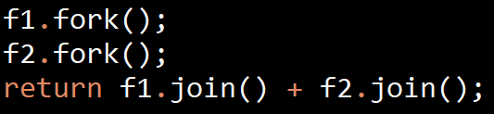
Question 2: Fibonacci parallelism
What if we swap the order?
Looks the same, but it is less preferred as it follows the convention of joins to be returned innermost first.
Since a thread forks tasks to the front of its own double-ended queue, the last task forked should be the one that is joined when the thread becomes idle.
This becomes apparent when we set the parallelism level to 0 using java.util.concurrent.ForkJoinPool.common.parallelism=0 The main thread actually blocks waiting for f2.join() is behind f1.join().

Slide 8
Bonus questions
Actual problems from CS2103T that I have encountered
Shows you that concepts will be used outside of CS2030 ☺

Slide 9
Generics + exceptions
Does this compile?
public class MyException<T> extends RuntimeException {
}
Nope.
Generic class may not extend java.lang.throwable

Slide 10
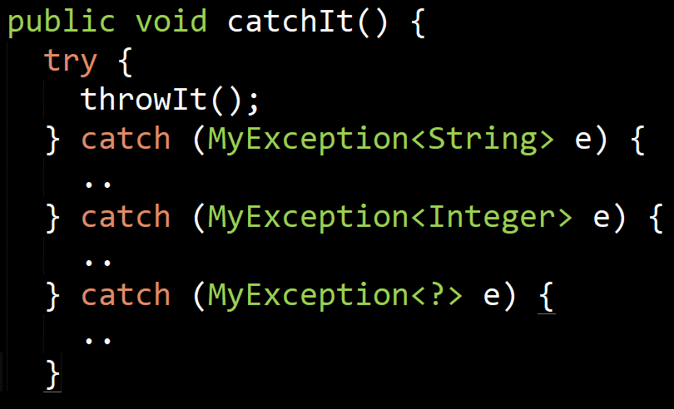
Why not?
Subclasses of Throwable (i.e. Exception, RuntimeExceptions cannot have a generic type parameter.
If you think about it, this makes sense. Suppose the code worked. Then how would you catch a generic exception?
For the generic type to be useful you need to be able to create multiple catch blocks this way.
But due to type erasure, at runtime MyException<String> will just be MyException. Then how will the compiler know which one to call?

Slide 11
What about this?
public class MyClass<T> {
private class MyInnerException extends Exception {
..
}
}
Doesn’t compile either.
But if you make the inner class static, this does solve the issue.
Notes:
It is not possible to define a (non generic) exception class inside a generic class. This is a bit strange because the exception itself has no generic type parameter. I cannot think of a reason why this should cause problems (if you can, please tell me!). Making the inner class static solves the compile error.

Slide 12
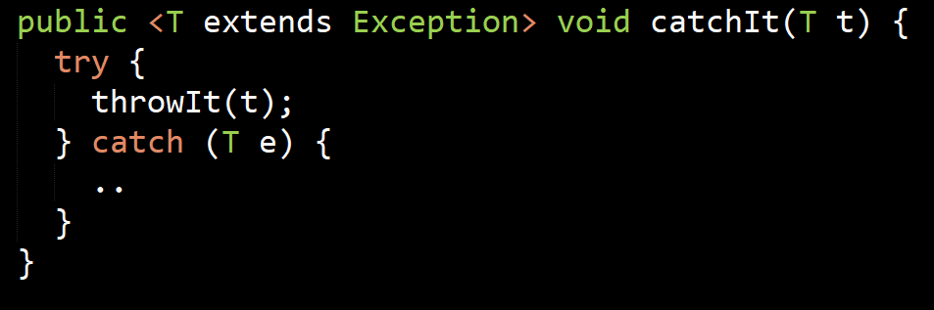
Utilizing generic exceptions
Can you do this?
This is fine
Compile error
Notes:
The reason for this is again, type erasure

Slide 13
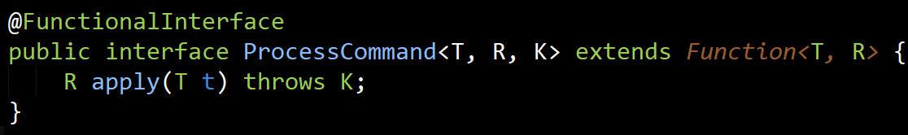
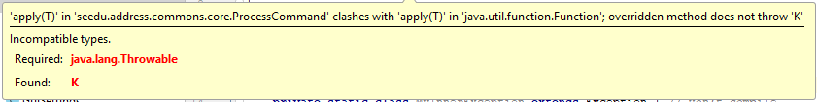
Extended functions
So we have Function<T, R>
Now I want to make a functional interface that also can throw exceptions
So I can write lambdas that can throw exceptions.
Something like:
Does this work?

Slide 14
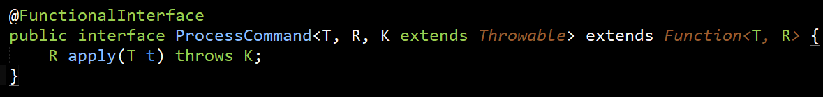
Bug fix #1
We make it extend Throwable!
Does this work?

Slide 15
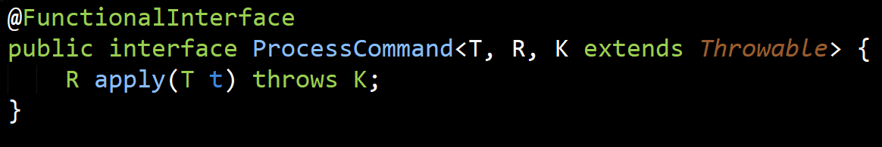
Bug fix #2
We remove it’s dependency to Function
Does this work?

